Slide 1
Listening at the Fenceline
Six months of continuous community noise monitoring in Howard County, Maryland
Chandra Prakash Choudhary
MS, Geography and Environmental Engineering · Johns Hopkins University
with Dr. Ana María Rule · Dr. Marsha Wills-Karp · Johns Hopkins Bloomberg School of Public Health
CEEJH Symposium · CHARMED Session II: Pilot Projects in Environmental Health Research
Bowie State University · 19 September 2026

Slide 2
INTRODUCTION · 1 OF 3
A community asked the question first
Residents reported a sound that never stopped.
Not a truck passing. Still there at 3 a.m.
A complaint without a measurement has nowhere to go.
By the time anyone arrives with a meter, the sound has changed.
So four households hosted the instruments themselves.
A meter in the back yard, recording every second, for six months.
2

Slide 3
INTRODUCTION · 2 OF 3
Noise is a health-relevant exposure
Night noise disturbs sleep even if it doesn't wake you up.
The body still responds. WHO set its 45 dB night guideline on that evidence. (2018)
Long-term night noise is linked to high blood pressure and heart disease.
WHO Europe: at least a million healthy life-years lost each year in Western Europe. (2011)
The exposure is not shared fairly, and it is rarely measured.
Industry and highways are located disproportionately in lower-income and minority neighbourhoods.
Air and water have monitoring networks; community noise has almost none.
3

Slide 4
INTRODUCTION · 3 OF 3
Why we measure Lₑq, and why we propose the use of L90
Leq – the average
All existing guidelines and regulations are based on Leq.
But Leq is an energy average: one dog, one siren, one passing truck can carry a whole night.
L90: the background floor
The level the sound stays above 90% of the time.
Passing events cannot move it. It shows what is always there, which is what a source that never switches off changes.
A normal neighbourhood's background floor drops sharply after dark. A home by a source that operates all night has no such drop. That day-night drop is the measurement.
Decibels are logarithmic: 60 dB + 60 dB = 63 dB. +3 dB is twice the sound energy; +10 dB sounds about twice as loud. All values A-weighted.
4

Slide 5
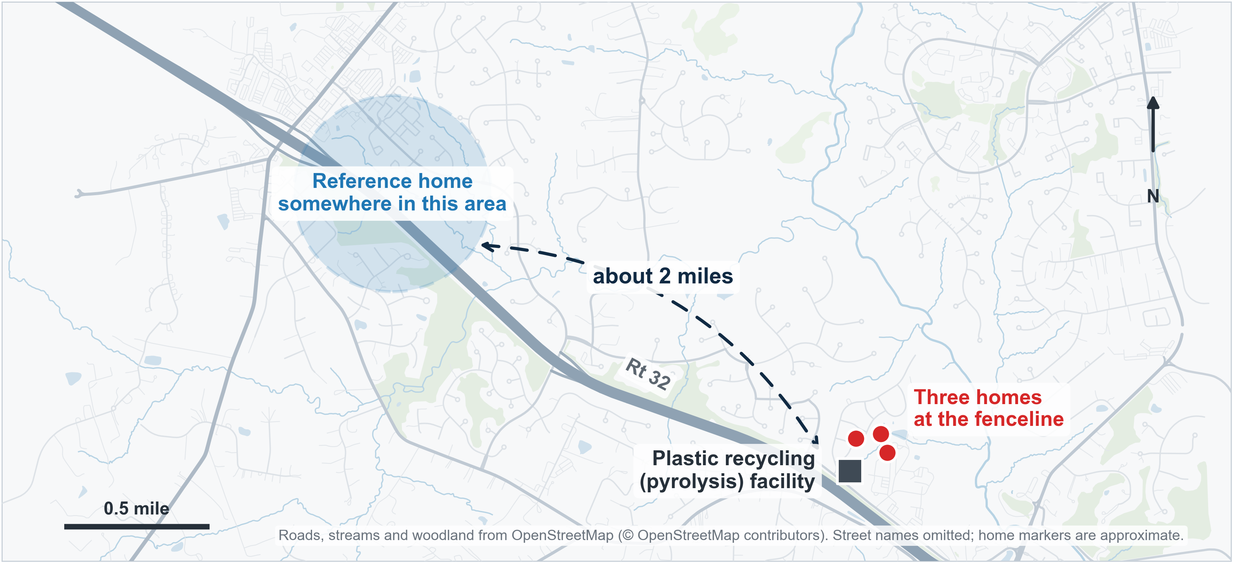
METHODS · 1 OF 2
Where we measured
Three homes at the fenceline · one reference home about 2 miles away · all four a similar distance from Rt 32 · Noise measurements collected from 1 March – 31 August 2026, continuous
The reference home is what makes the other numbers mean anything: without it, “48 dB at night” cannot be judged high or ordinary for this region.
5

Slide 6
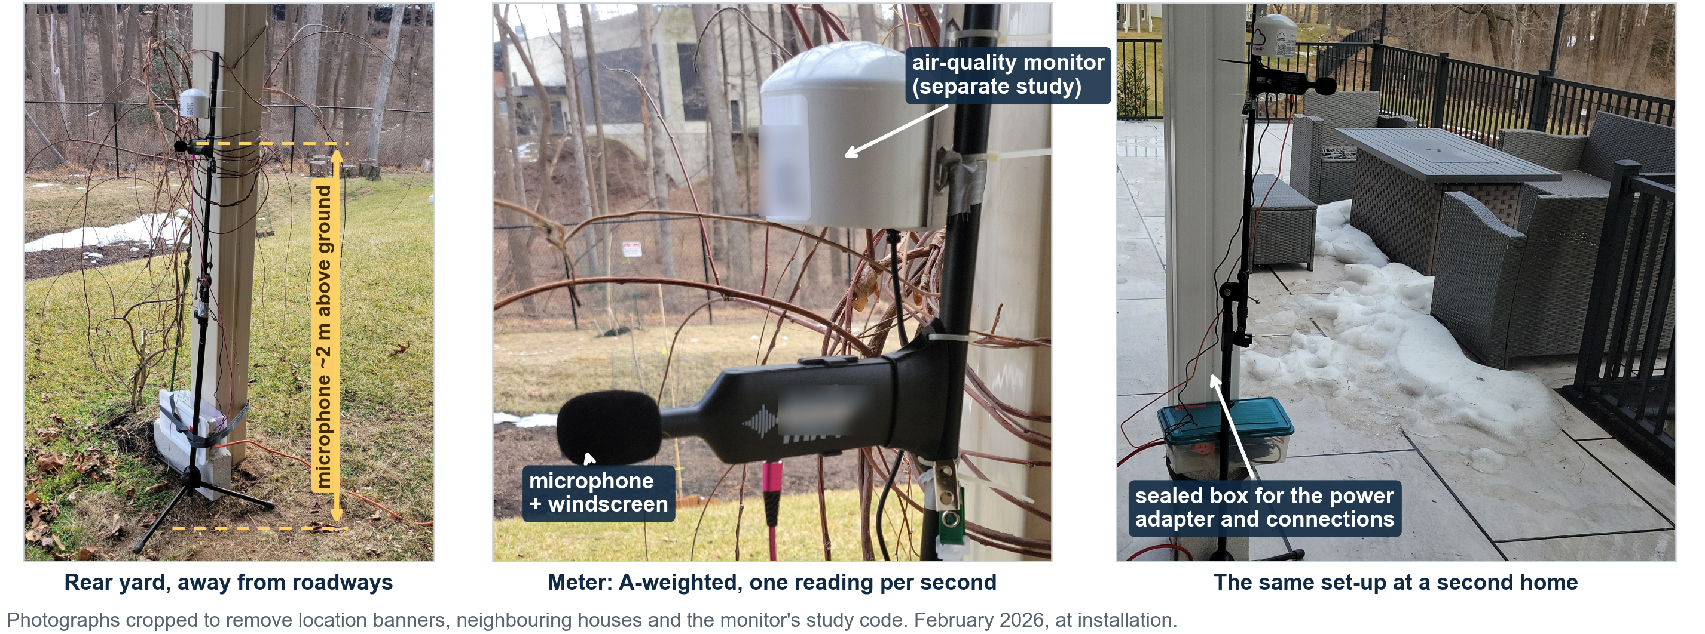
METHODS · 2 OF 2
How we measured
Instrument NSRT_W_mk4 logger, factory-calibrated. Meets IEC 61672-1:2002 accuracy; not a certified Class 1/2 meter.
Sampling One A-weighted Lₑq reading per second at each home, about 15 million readings per home over the six months.
Quality control A day or night period counts only if ≥75% of its length was recorded. Exclusions are listed, not dropped.
Placement Rear yard, ~2 m above ground, away from roadways, at the receiving residential property (COMAR 26.02.03.02D; ISO 1996-2).
Criteria WHO 2018: 45 dB at night, health-based. COMAR / Howard County §8.900: 55 dB night, 65 dB day, enforceable.
Analysis Open, version-controlled pipeline; every figure regenerates from the raw files.
6

Slide 7
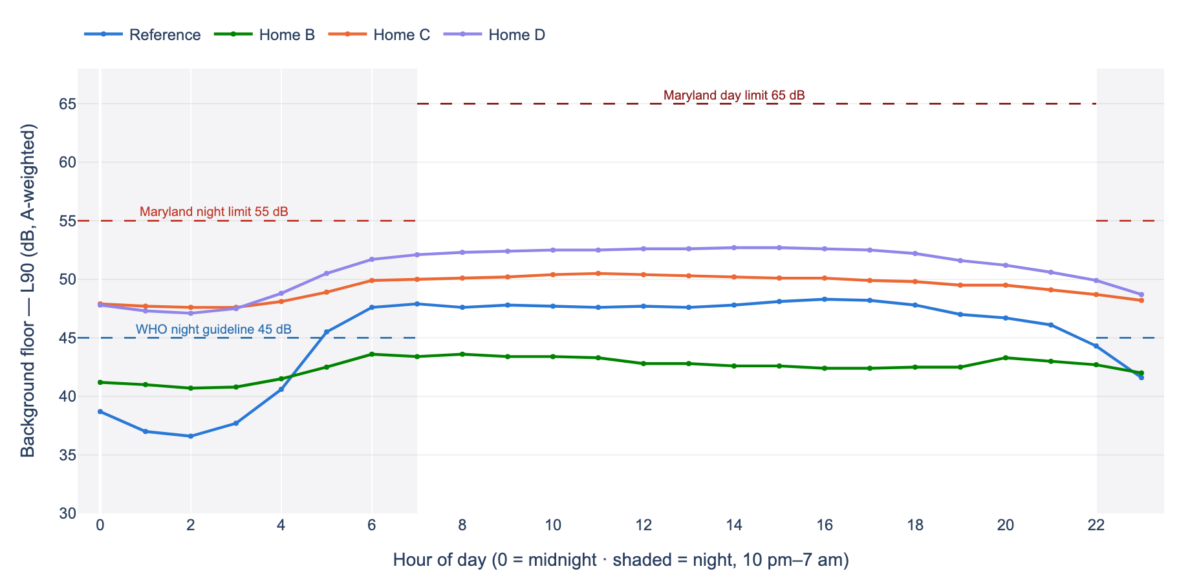
RESULTS · 1 OF 2
Average Background Floor Noise by time of day (6 m)
The reference home falls 8.3 dB after dark, to 36 dB in the early hours. Homes C and D fall 1.9 and 3.7 dB and stay near 50 dB around the clock. They have no quiet hours.
7

Slide 8
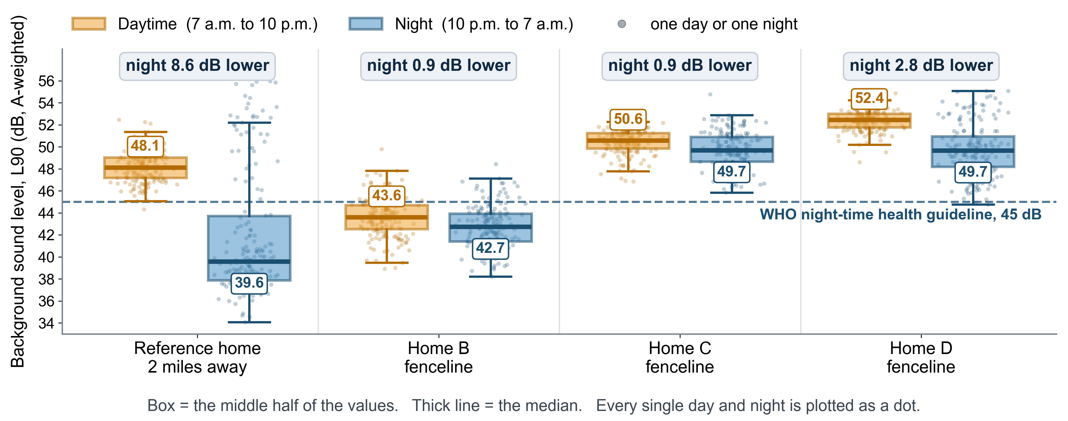
RESULTS · 2 OF 2
The background floor, day and night
The reference home goes quiet after dark. The fenceline homes do not.
At night, Homes C and D are louder than the reference neighbourhood is at midday. Their floor stayed above the WHO night guideline on 177 of 177 and 171 of 173 nights.
8

Slide 9
CONCLUSION 1 of 2
What these measurements do and do not show
What they establish
• Two fenceline homes have no quiet night: their floor stays above the WHO guideline all night, every night.
• Noise is chronic: the pattern held for six consecutive months.
• It is spatially clustered: the two most affected homes are close together and closer to the facility.
• The highway is shared by all four homes; it does not explain the difference.
What they do not
• Source cannot be identified. A meter measures exposure, not origin.
• The reference home crossed 55 dB on more nights than any fenceline home: 28 of 182, against 6, 6 and 18.
• Not a legal measurement loggers that meet IEC 61672-1:2002 accuracy but are not certified Class 1/2.
Control home is a regional reference, not a matched control
We chose the floor as the headline metric because that is what a continuous source affects.
9

Slide 10
CONCLUSION 2 of 2
Strengths and Limitations
Community-hosted monitoring turned a complaint into a measurement.
An open pipeline and a documented method give a result which a regulator can examine rather than dismiss.
The finding: two fenceline homes have no quiet night.
Continuously elevated for six months, above the WHO night-time health guideline.
The results were reported back to the residents first.
Each household got its own monthly and comprehensive report; one de-identified report lets residents share the findings without revealing location.
Next: a directional Class 1 survey, and monitoring through the seasons.
The only way to confirm a source and test for a tonal character, which would tighten Maryland's night limit to 50 dB.
Limitations:
monitoring was continuous and not screened for wind or rain
data capture varied by month, with March having fewer monitoring days at three homes.
10

Slide 11
Acknowledgements
Four households let us put an instrument in their back yard for six months. That is the reason this study exists.
Funding by CHARMED Center: National Institute for Environmental Health Sciences (NIEHS) P30 Center for Community Health: Addressing Regional Maryland Environmental Determinants of Disease (CHARMED) Center (grant P30ES032756) Pilot Program; PI: Wills-Karp
The analysis platform is open and online: https://noise-analysis-platform-ga5lsxtezq-uc.a.run.app/
Limitations: monitoring was continuous and not screened for wind or rain ·
COMAR expresses its limits as Lₑq but states no averaging period · data capture varied by month, with March lower at three homes.
References:
WHO Environmental Noise Guidelines (2018) · WHO Europe, Burden of Disease from Environmental Noise (2011) · COMAR 26.02.03 · Howard County Code §8.900 · ISO 1996-1/-2 · IEC 61672-1:2002 · basemap © OpenStreetMap contributors

Slide 12
Thank You
Questions are welcome

Slide 13
POCKET SLIDE · FOR QUESTIONS
All measured values, 1 March – 31 August 2026
 | Night L90 (floor) | Day L90 (floor) | Day-to-night drop | Night Lₑq (average) | Day Lₑq (average) | 24-hr Lₑq
Reference home (A), 2 mi away | 39.2 | 47.5 | 8.3 dB | 53.1 | 57.5 | 56.3
Home B, fenceline | 41.5 | 42.9 | 1.4 dB | 48.5 | 54.5 | 53.1
Home C, fenceline | 48.1 | 50.0 | 1.9 dB | 51.7 | 56.9 | 55.6
Home D, fenceline | 48.4 | 52.1 | 3.7 dB | 53.5 | 58.8 | 57.5
These are six-month energy averages over all readings. The night-by-night medians on slide 8 differ slightly. Both are reported.
dB, A-weighted. Night = 10 p.m.–7 a.m. (9 h contiguous); day = 7 a.m.–10 p.m. L90 = the level exceeded 90% of the time; no limit is set on L90. 24-hr Lₑq is all readings combined, not an average of the day and night columns, and not WHO's Lₑₑₙ, which penalises evening and night. WHO night guideline 45 dB; Maryland night limit 55 dB, day 65 dB.
12

